Slide 1
DDS Beer EDA Allen Hoskins and Fidel Tamares
Allen Hoskins: https://github.com/ahosk/MSDS-Case-Study-1
Fidel Tamares Repo: https://github.com/fideltamares/MSDS6306-_DDS_Case_Study1.git
Fidel Tamares Youtube: https://www.youtube.com/watch?v=99NSs5L7vF0

Slide 2
Dataset Review: Recommendation and Assumptions
We recommend states with a population greater than 5 million and less than 1 brewery per 100,000 citizens; states such as Texas, California and Florida. Focus on packaged beer sales first before onsite consumables and providing with a wide style selection starting with the most popular like IPAs.
Beer sales are assumed to be made within the state
National/Regional distribution not considered
Breweries are analyzed as independent of a parent ownership in other breweries
12oz beer sizes are Can and Bottle related while 16oz indicate pint glass size
Imported census data for further analysis
1,005 Beers removed for missing IBU data
Style guidelines determine beer ingredients/ABV/IBU ranges; style data is intact
*3. Address the missing values in each column

Slide 3
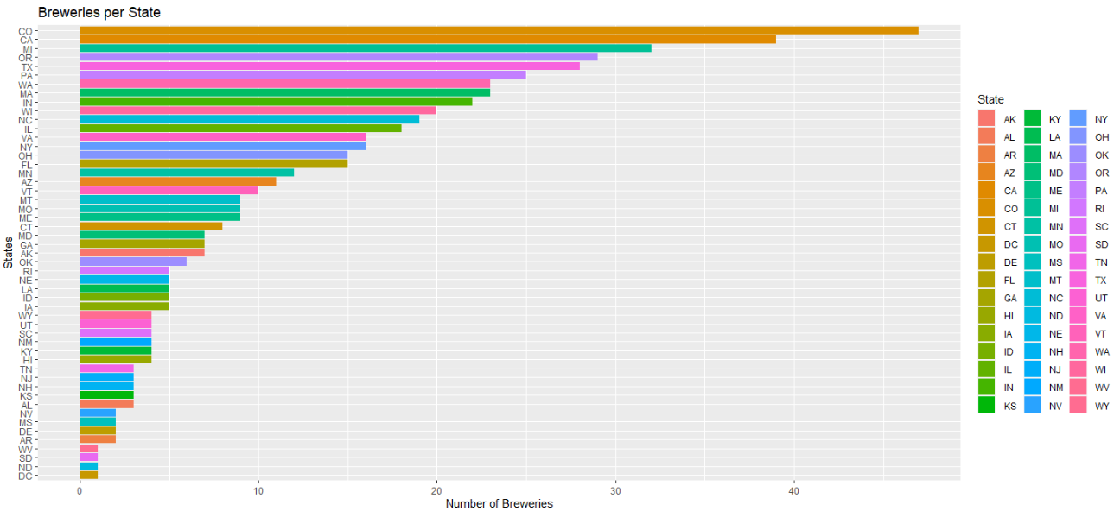
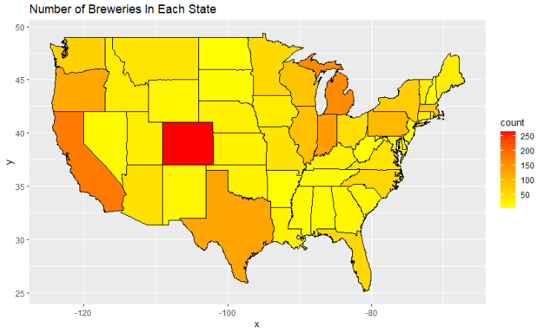
Basic Brewery and State information
Top 3 States by Styles of Beer:
Colorado with 265 Styles
California with 183 Styles
Minnesota with 162 Styles
States Average 11 breweries
5 States have more than 28 breweries
Total Beers Catalogued: 2,410
Total Breweries Cataloged: 558
*1. How Many Breweries are there in each state

Slide 4
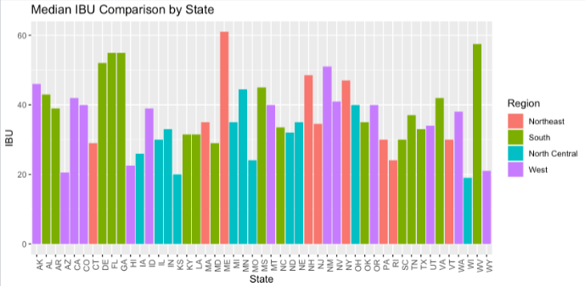
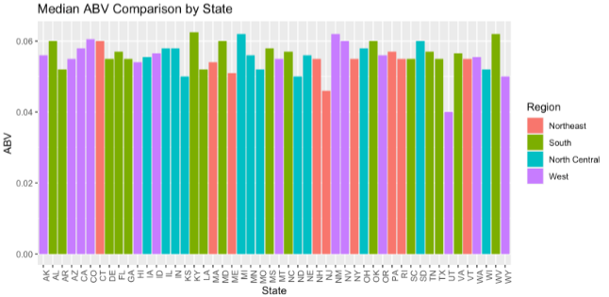
Dataset Review: Regional Preferences
IBU ranges from 4 to 138
The center of this range is 35 IBUs
The highest IBU Beer belongs to Astoria Brewing in Oregon
Top 3 Breweries with most styles
Brewery Vivant, 62, Michigan
Oskar Blues Brewery, 46, North Carolina
Sun King Brewery, 38, Indiana
Top 3 Styles:
American IPA
American Pale Ale
American Amber Ale
ABV ranges from .1% to 12.8%
The center of this range is 5.6%
The highest ABV Beer belong to Upslope Brewing in Colorado
*4. State and Region IBU Comparison *5. Highest IBU Beer

Slide 5
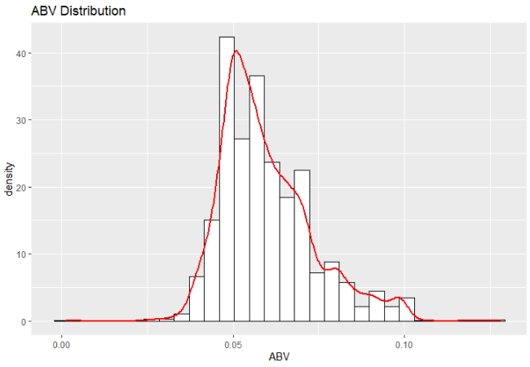
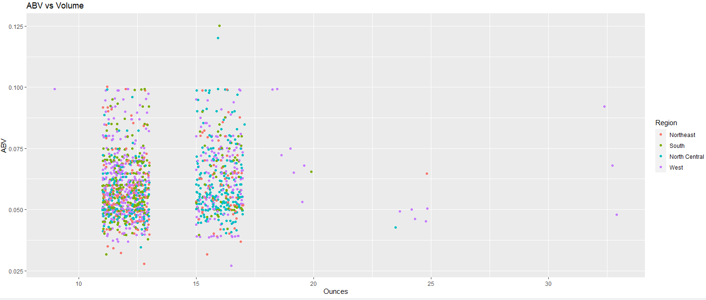
Dataset Review: Regional Preferences cont.
Average ABV: 5.97%
Supports market is moving towards higher ABV
Session beer (Less than 5% ABV) trend is declining
Most popular serving size is 12oz
Can/Bottle Assumption
Not consumed onsite
16oz is the next most popular size
Pint glasses
Consumed on site
1,525 Data Points
841 Data Points
6. Compare summary statistics and distribution of the ABV Variable

Slide 6
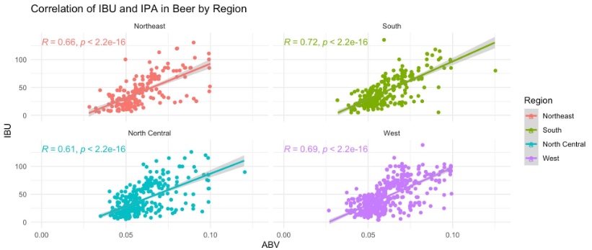
Dataset Review: Changes in Beer Preference
Relationship between IBU and ABV by Region
Trends are moving towards big bodied beers (5%+ * and 35+IBU **)
Predictive model with 86% accuracy based on IBU and ABV
Bigger beers cost more to produce
*5% Max ABV for session beers
**40 IBU max style range for Pale Ale, 40+ Can be considered IPA
7. Examine the relationship between the bitterness of the beer and its alcohol content

Slide 7
Dataset Review: Changes in Beer Preference
Relationship between IBU and ABV by Region
Trends are moving towards big bodied beers (5%+ * and 35+IBU **)
Predictive model with 86% accuracy based on IBU and ABV
Bigger beers cost more to produce
*5% Max ABV for session beers
**40 IBU max style range for Pale Ale, 40+ Can be considered IPA
7. Examine the relationship between the bitterness of the beer and its alcohol content

Slide 8
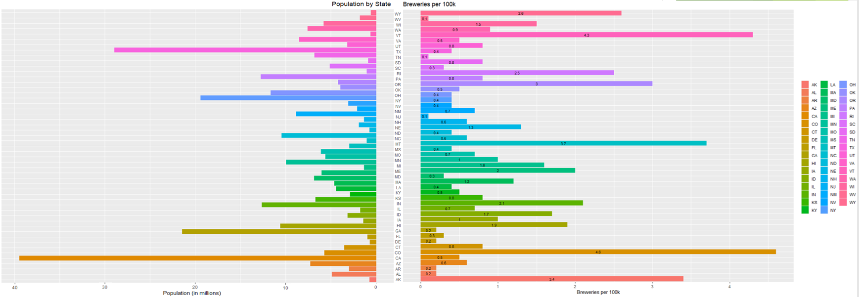
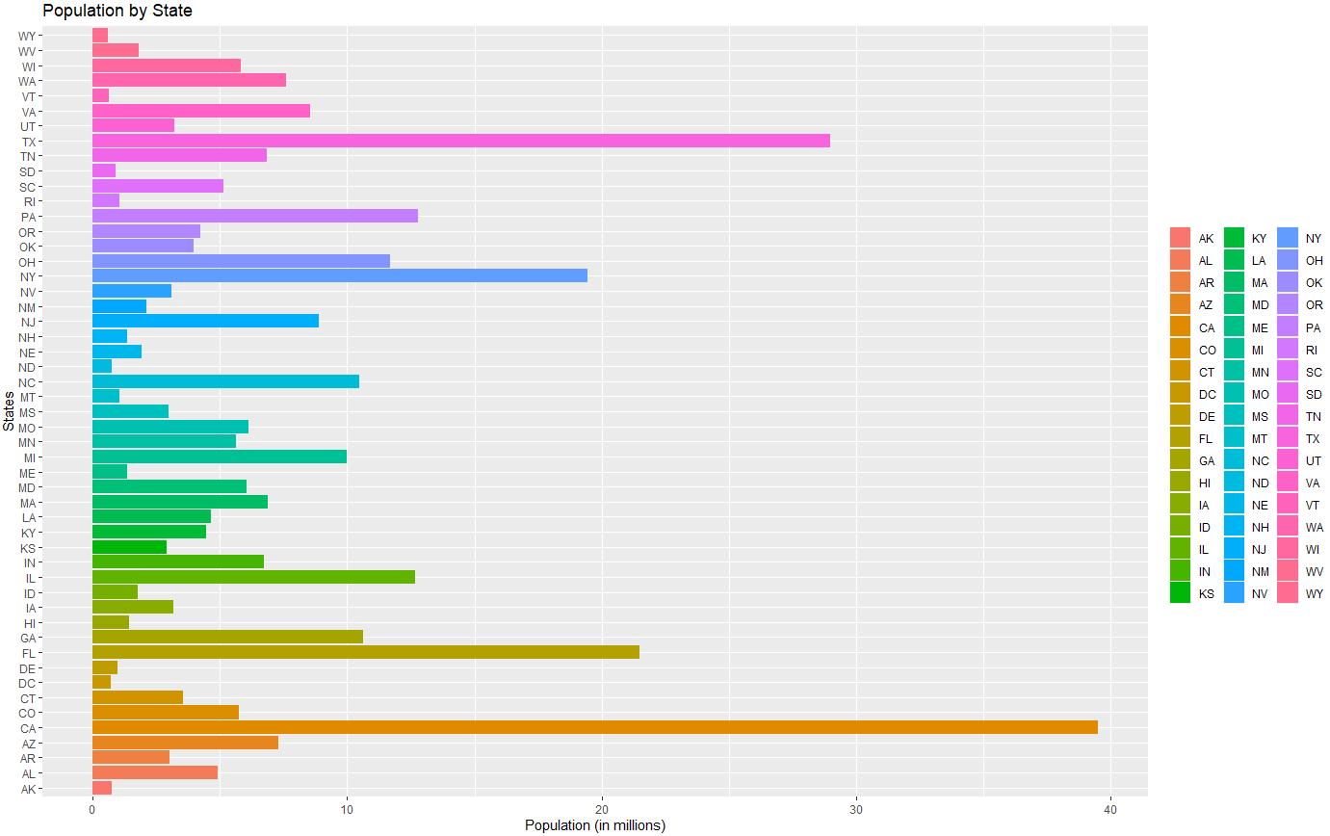
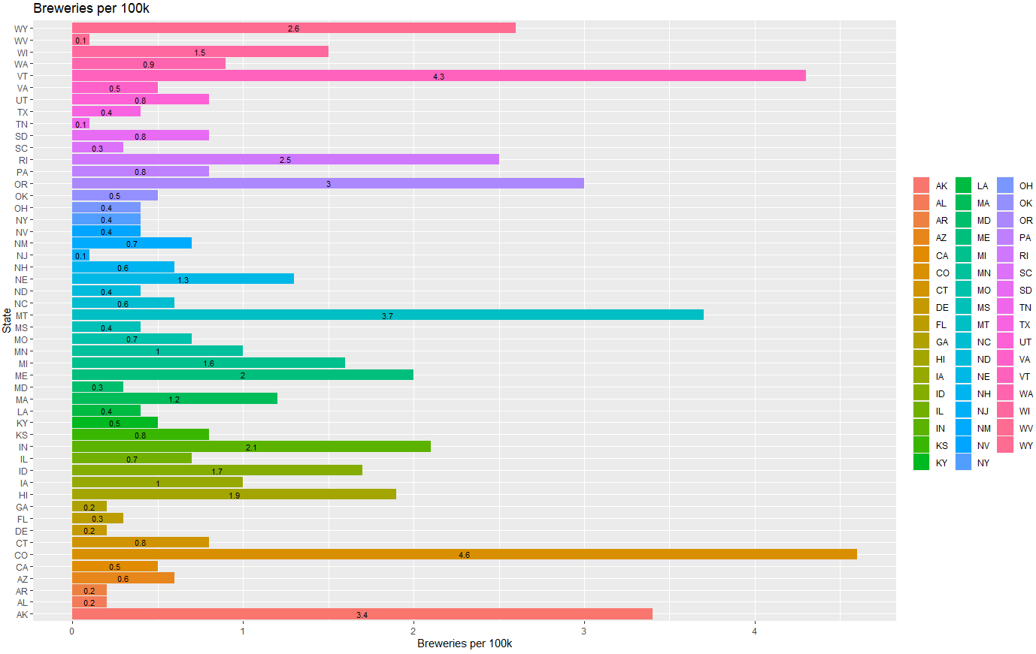
Market Analysis and Recap
Markets considered saturated (CA,TX, OH, GA) are low in Breweries per Capita but have high in population
Supports areas are dominated by few breweries, with many styles
Movement towards bigger beers (5%+ and 40 IBU+)
Locations may not be critical, most beer sales are in can sizes (12oz)
Regional customer preference
Number highly capable competitors bigger factor than the number of breweries

